Slide 1

LARAVEL CERTIFICATE COURSE
Name: Henil Patel
Enrollment No.: 23000004
Batch: B(SYBCA)

Slide 2
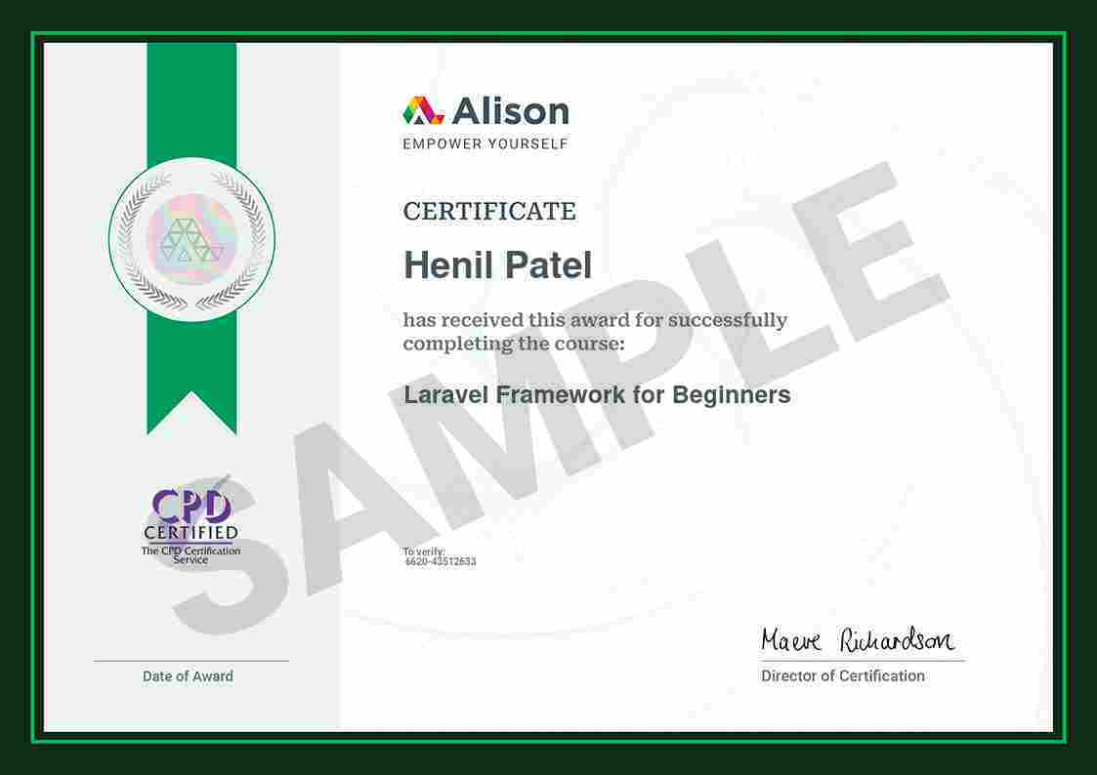

Slide 3
Introduction of Laravel Framework
Laravel is a popular PHP framework designed to make web development easier and faster.
It provides a robust set of tools and resources to build and maintain modern PHP applications, including user authentication, database management, and routing.
Laravel follows the Model-View-Controller (MVC) architecture, which helps in organizing code logically, making it more readable and maintainable.
It also includes built-in features like templating, caching, and security, making it a powerful choice for creating full-featured web applications efficiently.

Slide 4
What's the Laravel Purpose?
Laravel streamlines development with clean, expressive syntax, making common tasks easier. This allows developers to focus on building unique application features, reducing repetitive coding.
Laravel accelerates development with a vast library of pre-built components and tools, giving developers a strong foundation to build robust applications without starting from scratch.
Laravel includes essential features like routing, authentication, caching, and sessions. These built-in tools save developers from recreating standard functionalities, allowing them to focus on the unique aspects of their applications.
Laravel’s elegant syntax, simplified tasks, and extensive tools empower developers to build sophisticated, feature-rich applications quickly, fostering creativity and efficiency.

Slide 5
Advantages
Scalability and Maintainability: Laravel’s MVC structure keeps code organized and separate, making it easier to scale and maintain as the application grows.
Extensive Ecosystem: Laravel has a wide range of packages for added functionality, from authentication to complex API integrations, enabling developers to easily use pre-built solutions.
Community Support and Documentation: Laravel has a strong community with active forums, tutorials, and resources, making it easy for developers to find answers and stay updated on best practices.
Modern Tooling and Features: Laravel incorporates modern PHP tools like Eloquent ORM (Object-Relational Mapper) for database interactions, Blade for templating, Artisan CLI for automation, and robust testing utilities, improving the development experience.

Slide 6
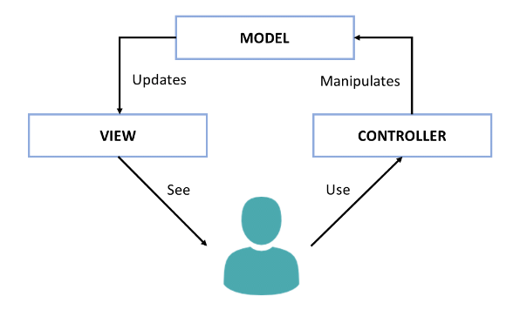
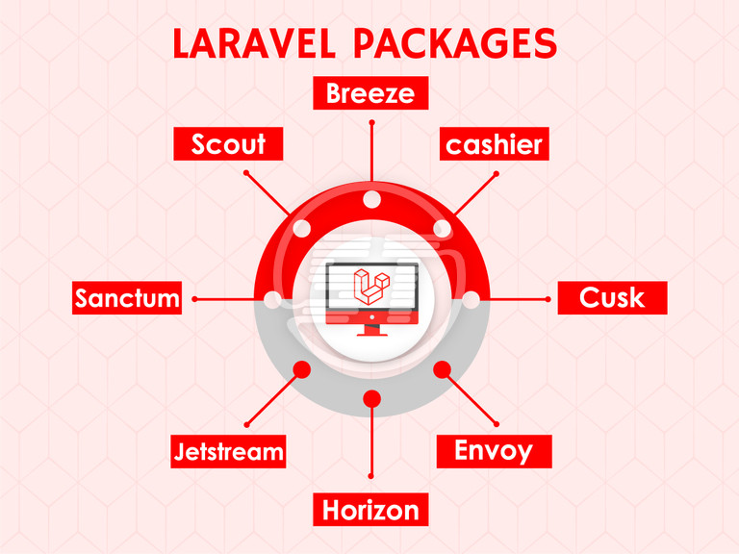



Slide 7
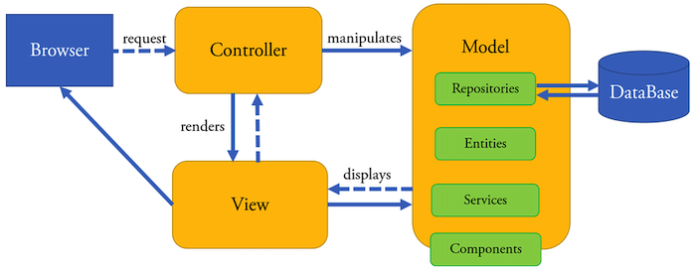
MVC Architecture
The Model-View-Controller (MVC) architecture is a design pattern in web development that divides an application into three components: Model, View, and Controller. In Laravel, MVC is essential for organizing and structuring code effectively. Here's an overview of Model-View-Controller (MVC) architecture:

Slide 8
Here's an overview of each element and its significance within Laravel:
Model (M)
View (V)
Controller (C)
Purpose: The Model handles the application’s data and business logic, managing interactions with the database, including data access, manipulation, and validation.
Significance in Laravel: In Laravel, Models are PHP classes linked to database tables. They define relationships, perform CRUD operations, and enforce business rules.
Purpose: The View displays data to users and includes user interface elements like HTML, CSS, and JavaScript.
Significance in Laravel: In Laravel, Views are made using the Blade templating engine or plain PHP, enabling dynamic, reusable templates that present data from Controllers.
Purpose: The Controller serves as a link between the Model and View. It manages user requests, processes input, retrieves data from the Model, and sends it to the View for display.
Significance in Laravel: In Laravel, Controllers are PHP classes that handle HTTP requests. They include methods for different user interactions, retrieve and manipulate data from Models, and pass it to the appropriate View for rendering.

Slide 9
Significance of MVC in Laravel
Separation of Concerns: MVC clearly separates responsibilities: Models manage data, Views handle presentation, and Controllers control the application flow. This improves code organization, readability, and maintainability.
Code Reusability: Each MVC component can be developed independently. Views can be reused with different Controllers, and Models can be shared across the application, reducing duplication and increasing efficiency.
Scalability and Maintainability: MVC's separation of components makes applications easier to maintain and scale. Changes in one component, like updating the Model’s database schema, don't affect the others directly.
Supports Testing: The separation of concerns allows for unit testing, enabling developers to test Models, Views, and Controllers independently to ensure each component works correctly.
In Laravel, using the MVC pattern helps developers build well-structured and maintainable applications by clearly separating the responsibilities of the Model, View, and Controller components.

Slide 10
Examples of MVC in the Laravel
Model (M):
View (V):
Controller (C):
Model is represented by Eloquent ORM entity:
<?php
namespace App;
use Illuminate\Database\Eloquent\Model;
class User extends Model
{
public function posts() {
return $this->hasMany(Post::class);
}
}
View is represented by Blade Templates:
<!-- resources/views/users/show.blade.php
-->
<h1>User Profile</h1>
<p>Name: {{ $user->name }}</p>
<p>Email: {{ $user->email }}</p>
Controller is represented by the corresponding classes:
<?php
namespace App\Http\Controllers;
use App\User; use Illuminate\Http\Request;
class UserController extends Controller
{
public function show($id) {
$user = User::find($id);
return view('users.show', ['user' => $user]);
}
}

Slide 11
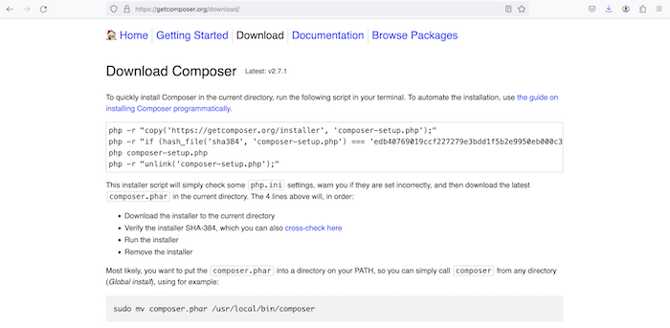
Step 1: Install Composer

Slide 12
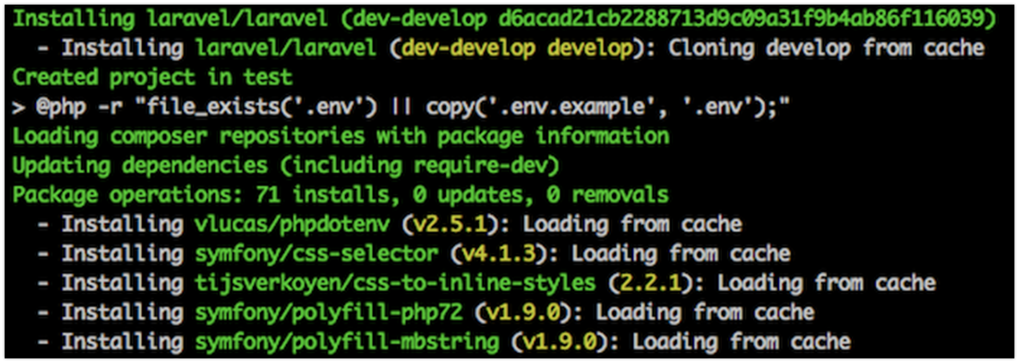
Step 2: Create a Laravel Project
After installing Composer, open your terminal and navigate to the desired directory for your Laravel project. Run this command: composer create-project --prefer-dist laravel/laravel laravel-project
Replace laravel-project with your preferred project name. This command will download and install the latest version of Laravel and its dependencies.

Slide 13
Step 3: Set Application Key
Navigate to your project directory: cd laravel-project
Then, run this command to generate the application key: php artisan key:generate
This command creates a random application key and adds it to your .env file, which Laravel uses for encryption and security operations. Setting the application key is crucial for security, as it serves as a salt or secret key for various functions in the Laravel framework, including encryption and hashing.
Encryption & Decryption: Laravel uses the application key to encrypt and decrypt data, like session data, cookies, and sensitive information.
Security Hashing: The key acts as a salt for hashing user passwords, enhancing the security of stored credentials.
Secure Cookies: Laravel uses the application key to sign cookies, ensuring they haven't been tampered with during transmission.

Slide 14
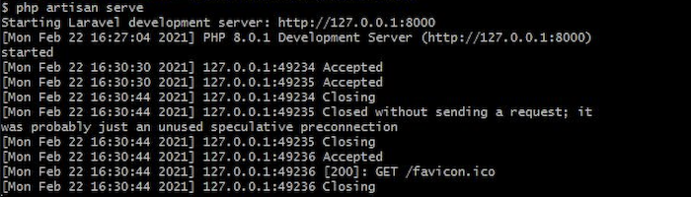
Step 4: Serve the Application
You can run your Laravel application using the built-in PHP development server with this command: php artisan serve
This starts a development server at http://127.0.0.1:8000.

Slide 15
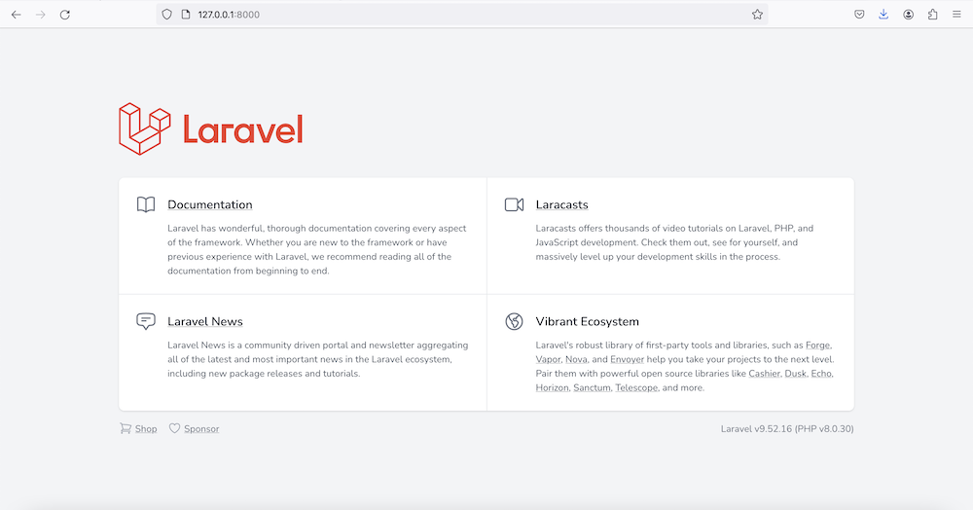
Step 5: Access Your Application
Open a web browser and go to http://127.0.0.1:8000 to see your Laravel application running.
You’ve successfully installed Laravel with Composer and can now start building your application using its powerful features!

Slide 16
Laravel Framework Key Folders
In a fresh Laravel project, you'll find several important folders that organize various aspects of the application:
(a) app: This is the core of your application and contains:
Console: Artisan commands.
Exceptions: Exception handling.
Http: Controllers, middleware, form requests, and route definitions.
Models: Data models for your application.
Providers: Service providers management.
(b) bootstrap: This folder contains files that bootstrap the Laravel application and load necessary components.
(c) config: Holds configuration files for different application parts, like database connections and cache settings.
(d) database: Contains database-related files:
migrations: Files for database schema changes.
seeds: Files to populate the database with test data.

Slide 17
Laravel Framework Key Folders 2
(a) public: This is the entry point of your application, containing the index.php file and publicly accessible assets like CSS, JavaScript, and images.
(b) resources: This directory stores non-PHP resources, including:
views: Blade templates for the UI.
lang: Language files for internationalization.
(c) routes: Contains route definitions that organize how HTTP requests are handled.
(d) storage: Holds temporary files generated by the application, such as logs, cache, and session files.
(e) tests: Contains test cases for your application.
(f) vendor: This folder holds Composer dependencies, including the Laravel framework and other libraries/packages used in your project.
These folders help keep a clear separation of concerns and organize the various aspects of a Laravel app.

Slide 18
Laravel "App" Folder Structure
The "app" folder is essential in a Laravel application, containing the core code and the following subfolders:
(a) Console: Contains Artisan commands and console functionality.
(b) Exceptions: Houses custom exception classes.
(c) Http: Contains controllers, middleware, and form requests for handling HTTP requests.
(d) Jobs: Stores queued job classes.
(e) Listeners: Holds event listener classes for managing events and broadcasting.
(f) Mail: Contains classes for building and sending emails.
(g) Models: Home to Eloquent model classes that represent database tables.
(h) Notifications: Holds classes for defining notification messages.
(i) Policies: Contains policy classes for handling authorization.
(j) Providers: Houses service providers that bootstrap and configure the application.
(k) Rules: Stores custom validation rule classes.
(l) Traits: A place for reusable traits that can be applied across multiple classes.

Slide 19
Active Record Introduction
Active Record is a design pattern that offers an object-oriented way to access and manipulate data in a database. It encapsulates business logic within the model, allowing developers to interact with the database through a simple and intuitive API. Laravel's Eloquent ORM is an implementation of this pattern.
Here are key concepts and features related to the Active Record pattern:
Model Representation: In Active Record, a model class represents a database table, with each instance of the model corresponding to a record in that table.
CRUD Operations: Active Record simplifies database interactions by offering methods for Create, Read, Update, and Delete (CRUD) operations. Models usually include methods like create, find, update, and delete for these tasks.
Relationships: Active Record makes it easy to manage relationships between tables. Eloquent models define relationships like one-to-one, one-to-many, and many-to-many using methods such as hasOne, hasMany, and belongsTo.
Validation: Active Record models often include validation rules. Laravel's Eloquent lets you define these rules for model attributes.

Slide 20
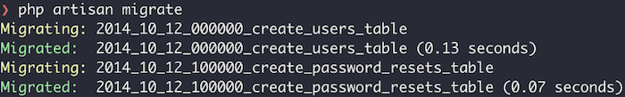
Migrations in the Laravel:
In Laravel, migrations are a powerful tool for managing database schema changes and version control. They let you define and modify the structure of your database tables over time. To create a new migration, use the make:migration Artisan command, like this:
php artisan make:migration create_users_table
This command creates a new migration file in the database/migrations directory. Each migration file has two methods: up, which defines the changes to the database, and down, which specifies how to reverse those changes. To run pending migrations, use the migrate Artisan command: php artisan migrate

Slide 21
Eloquent in the Laravel
Eloquent Models are the backbone of database interaction in Laravel, offering an elegant way to work with databases. They act as an abstraction layer, representing tables and allowing intuitive, object-oriented data manipulation. Eloquent replaces the need for raw SQL queries with a clean, expressive syntax.
Location: By convention, Eloquent Models are placed in the app/Models directory, but you can customize the location if needed.
Creating a Model: To create a new model using Artisan, run:
php artisan make:model YourModel
This command generates a new Eloquent Model file named YourModel.php in the app/Models directory by default, representing data from the your_models table. You can retrieve, create, update, and delete entities with this model.

Slide 22
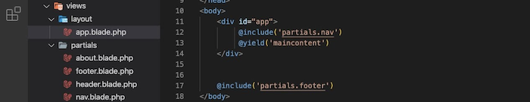
View Introduction
Views in Laravel are the UI components of your web application that help display information. Blade, the templating engine, makes it easy to create these views. Blade files have a .blade.php extension and are stored in the resources/views directory. You can use a Blade template in a controller using the view helper.
For example, if you create an app.blade.php template, you can use it in a controller action like this:
$name = 'John Doe';
return view('app', compact('name'));

Slide 23
Blade Engine Directives
Blade provides useful directives for control structures, simplifying the implementation of logic in your views. Some popular directives include @section, @show, @yield, @extends, @include, @for, @foreach, @if, and @else.
Examples:
@extends('layouts.app')
@section('content') <p>This is the content of the child view.</p> @endsection
@foreach($users as $user) <p>{{ $user->name }}</p> @endforeach
@if($condition)
<p>Condition is true.</p>
@elseif($anotherCondition)
<p>Another condition is true.</p>
@else
<p>Neither condition is true.</p>
@endif

Slide 24
Controller Introduction
In Laravel, a controller is a class that handles incoming HTTP requests and manages the application's logic to produce the right HTTP response. It acts as a bridge between the model (which manages data) and the view (which displays the user interface), playing a key role in maintaining the separation of concerns in the MVC (Model-View-Controller) architecture.
Key purposes of Laravel controllers include:
Handling HTTP Requests: Controllers are responsible for managing incoming HTTP requests from clients, such as web browsers or mobile applications.
Application Logic: Controllers hold the application's logic, including data manipulation, validation, and interactions with the model to fetch or update data.
Routing and Actions: Controllers are linked to specific routes in Laravel and define the actions or methods that execute when those routes are accessed.
Response Generation: Controllers create the appropriate HTTP responses to send back to the client, which can include rendering views, returning JSON, or handling redirects.

Slide 25
Define Controller
Method 1: Using Artisan Command:
To create a new controller with Artisan, open your terminal, navigate to your Laravel project's root directory, and run: php artisan make:controller UserController
Replace "UserController" with your preferred controller name. This command generates a new controller file in the app/Http/Controllers directory.
Method 2: Manual Creation:
Create a new PHP file in the app/Http/Controllers directory, such as UserController.php . The basic structure should look like this:
<?php
namespace App\Http\Controllers;
use Illuminate\Http\Request;
class UserController extends Controller {}
After creating the controller, you can define methods within it to handle different HTTP requests and perform various actions in your application.

Slide 26
Routing Introduction
In Laravel, routes are defined in routes/web.php for web routes and routes/api.php for API routes. The basic syntax for defining a route is:
Route::get('/example', function () { return 'Hello, this is an example route!'; });
This defines a route for the HTTP GET method that maps to the /example URI, returning a simple string when accessed.
You can also define routes that point to controller methods for better code organization:
Route::get('/user/{id}', 'UserController@show'); // let's call 'show' action
In this case, the show method of the UserController will be called when the route is accessed.

Slide 27
Using Named Routes
We can use the name() method to assign a specific name to a route.
Route::get('/users', 'UsersController@list')->name('users’);
Then, we can use the defined name to refer to the route from various places.
Show the named route as the URL in the view template:
<a href="{{ route('users') }}">Go to Users Page</a>
You can also use the named route in the controller. After performing an action, you can redirect the user to the "users" route like this:
public function update() {
// performing some update operations and then
return redirect()->route('users');
}

